Slide 1
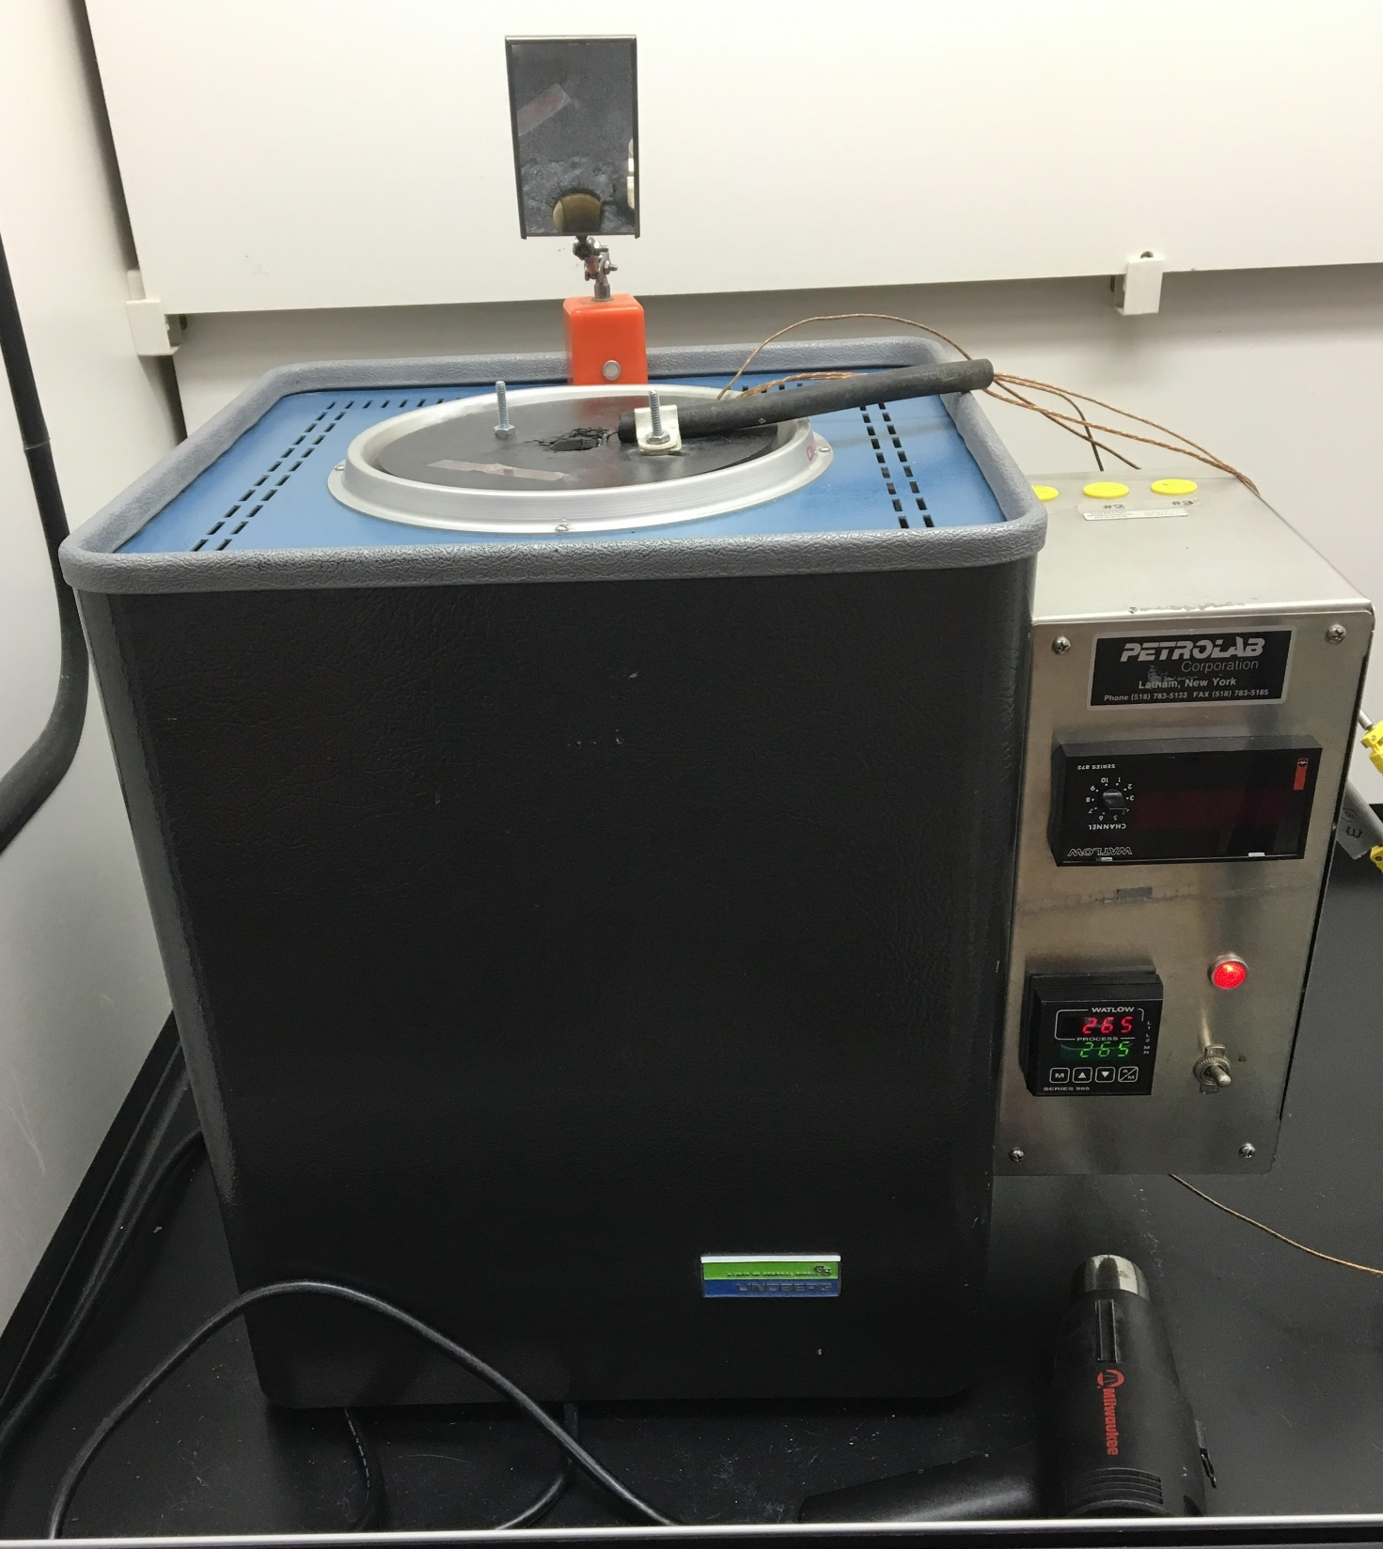
Flask-Lid Assembly
Mirror
Injection Hole
Thermocouple Wires
Power Indicator light
Temperature Controller
Power Switch
Heat Gun

Slide 2
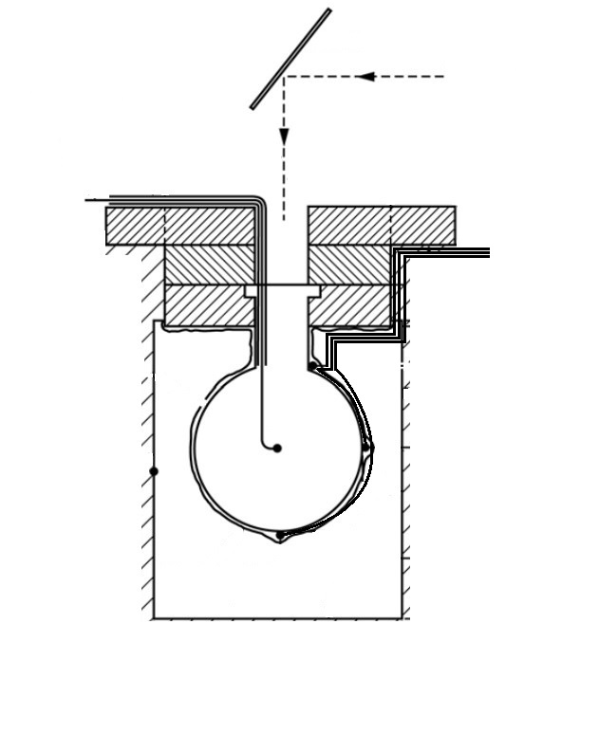
Mirror
Viewing
Line
To TA-DA
Thermocouple
Wires to TA-DA
500 mL
Bulb Flask
Control
Thermocouple
Furnace Wall
/Insulation
Aluminum Foil
Wrap
T1
T4
T2
T3

Slide 3
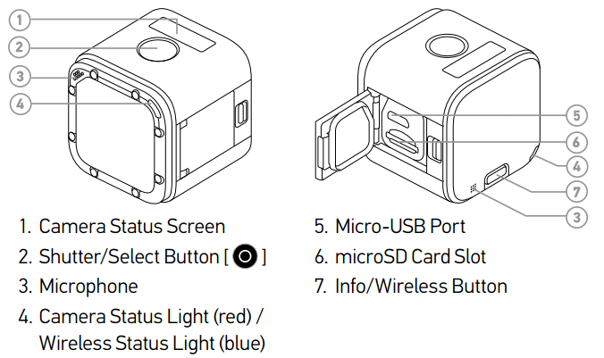

Slide 4
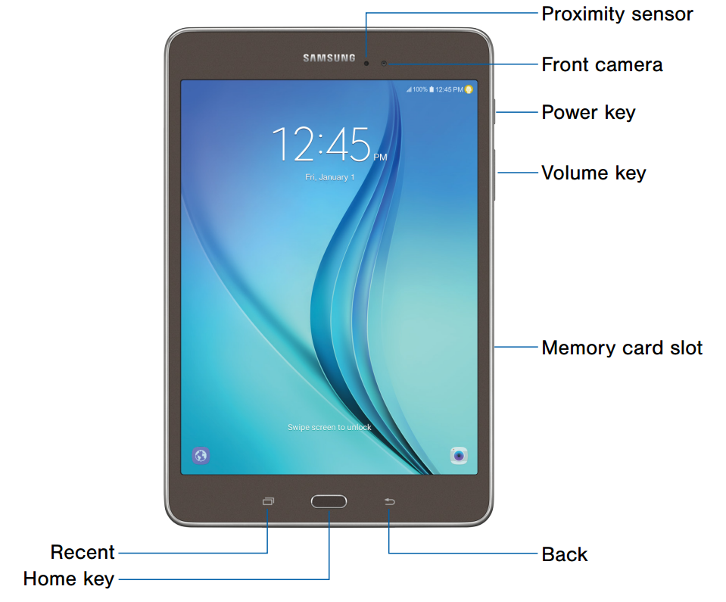
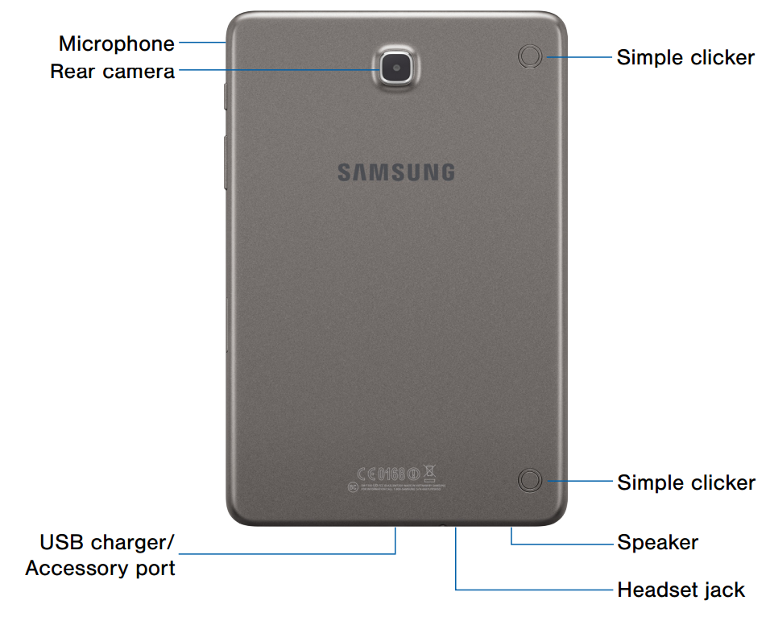

Slide 5
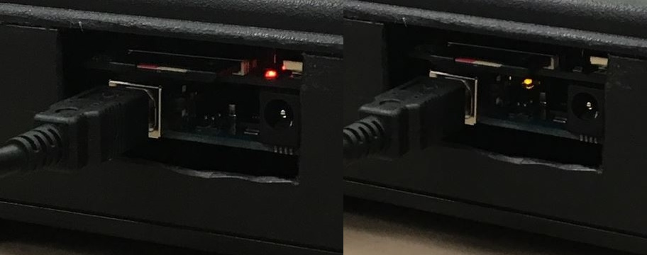
SD Write LED
Serial Communication LED

Slide 6
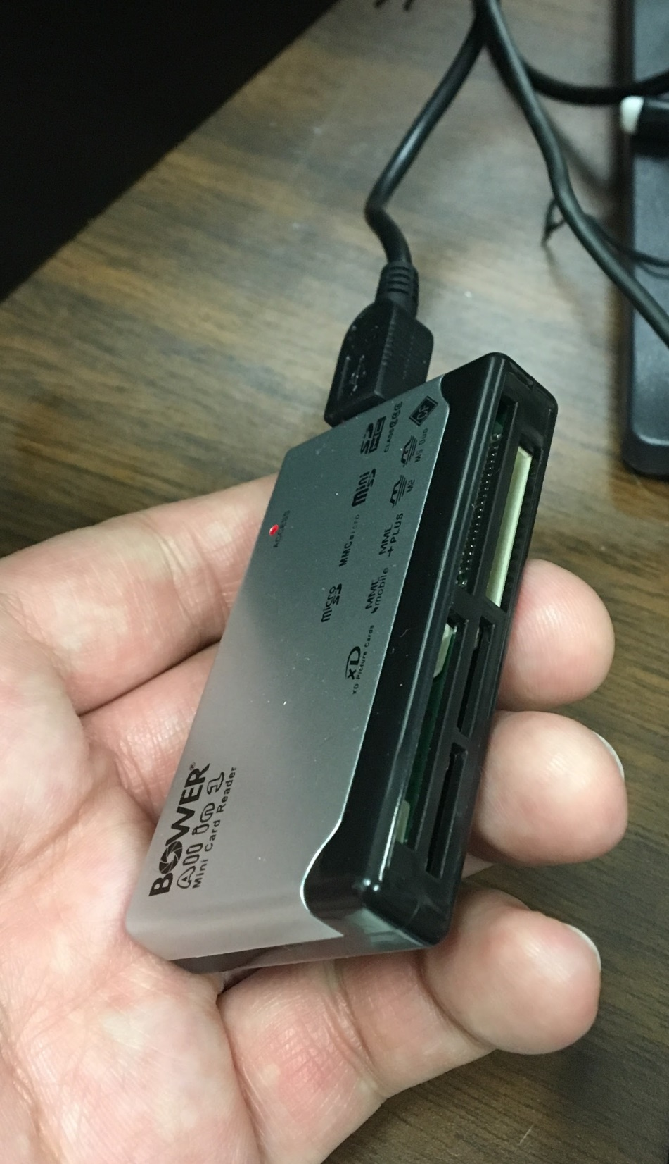
SD Card Slot

Slide 7
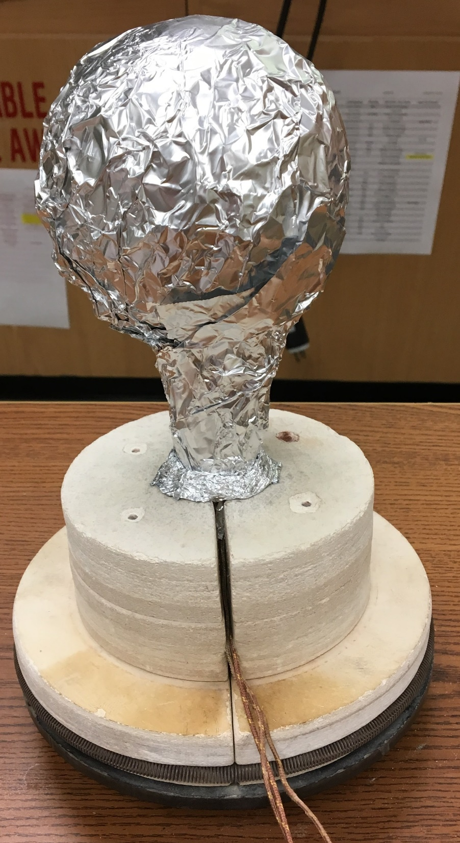
Foil Donut
Circular Spring

Slide 8
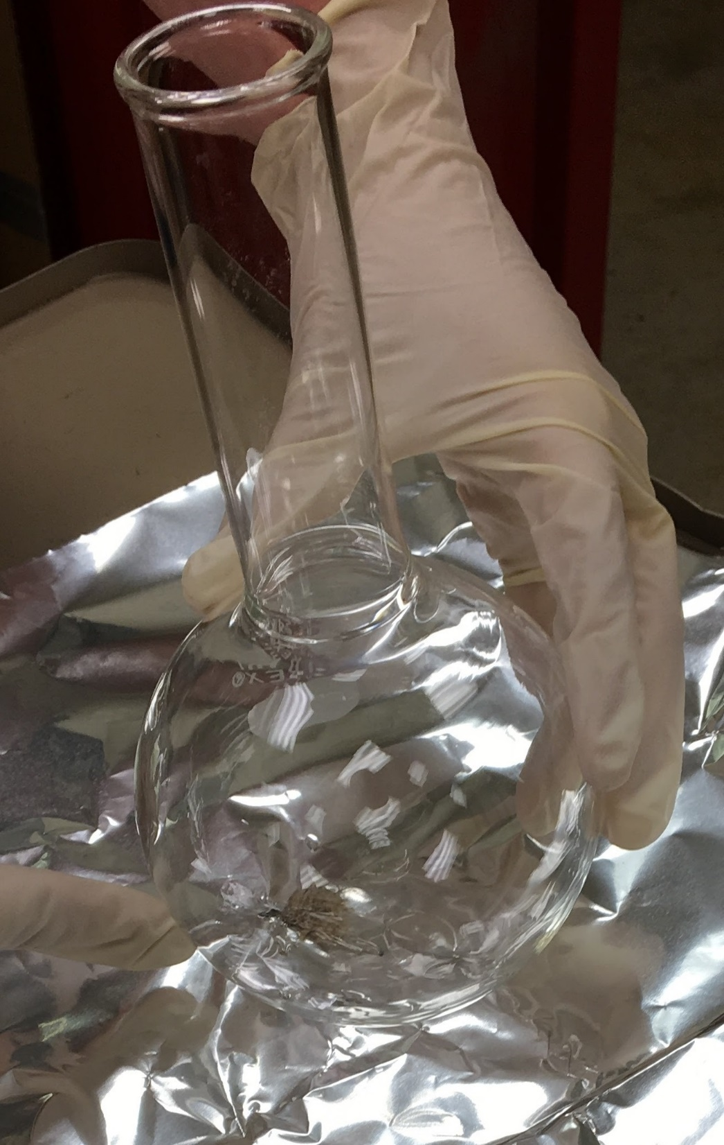
Thermocouple 3

Slide 9
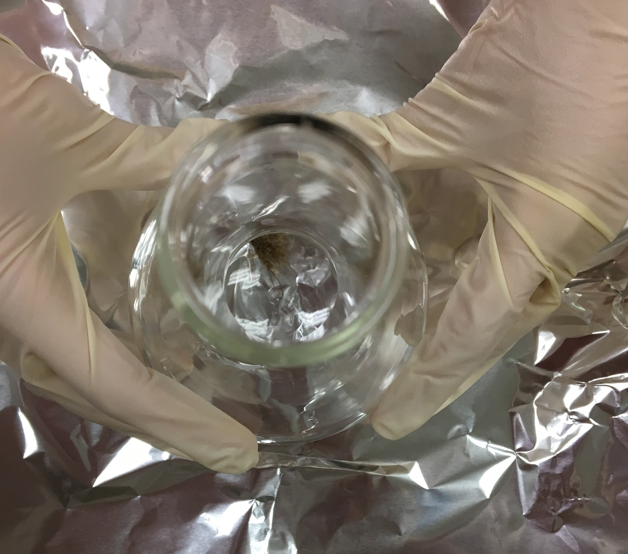
Thermocouple 3

Slide 10
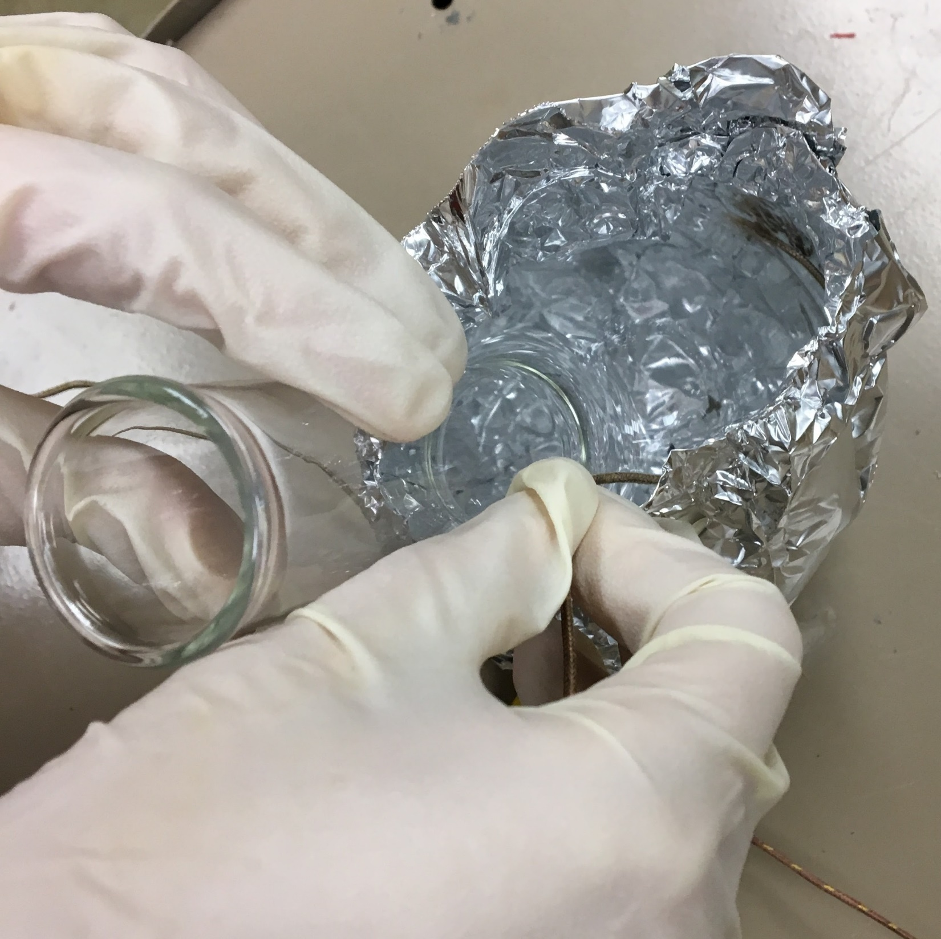
Thermocouple 2

Slide 11
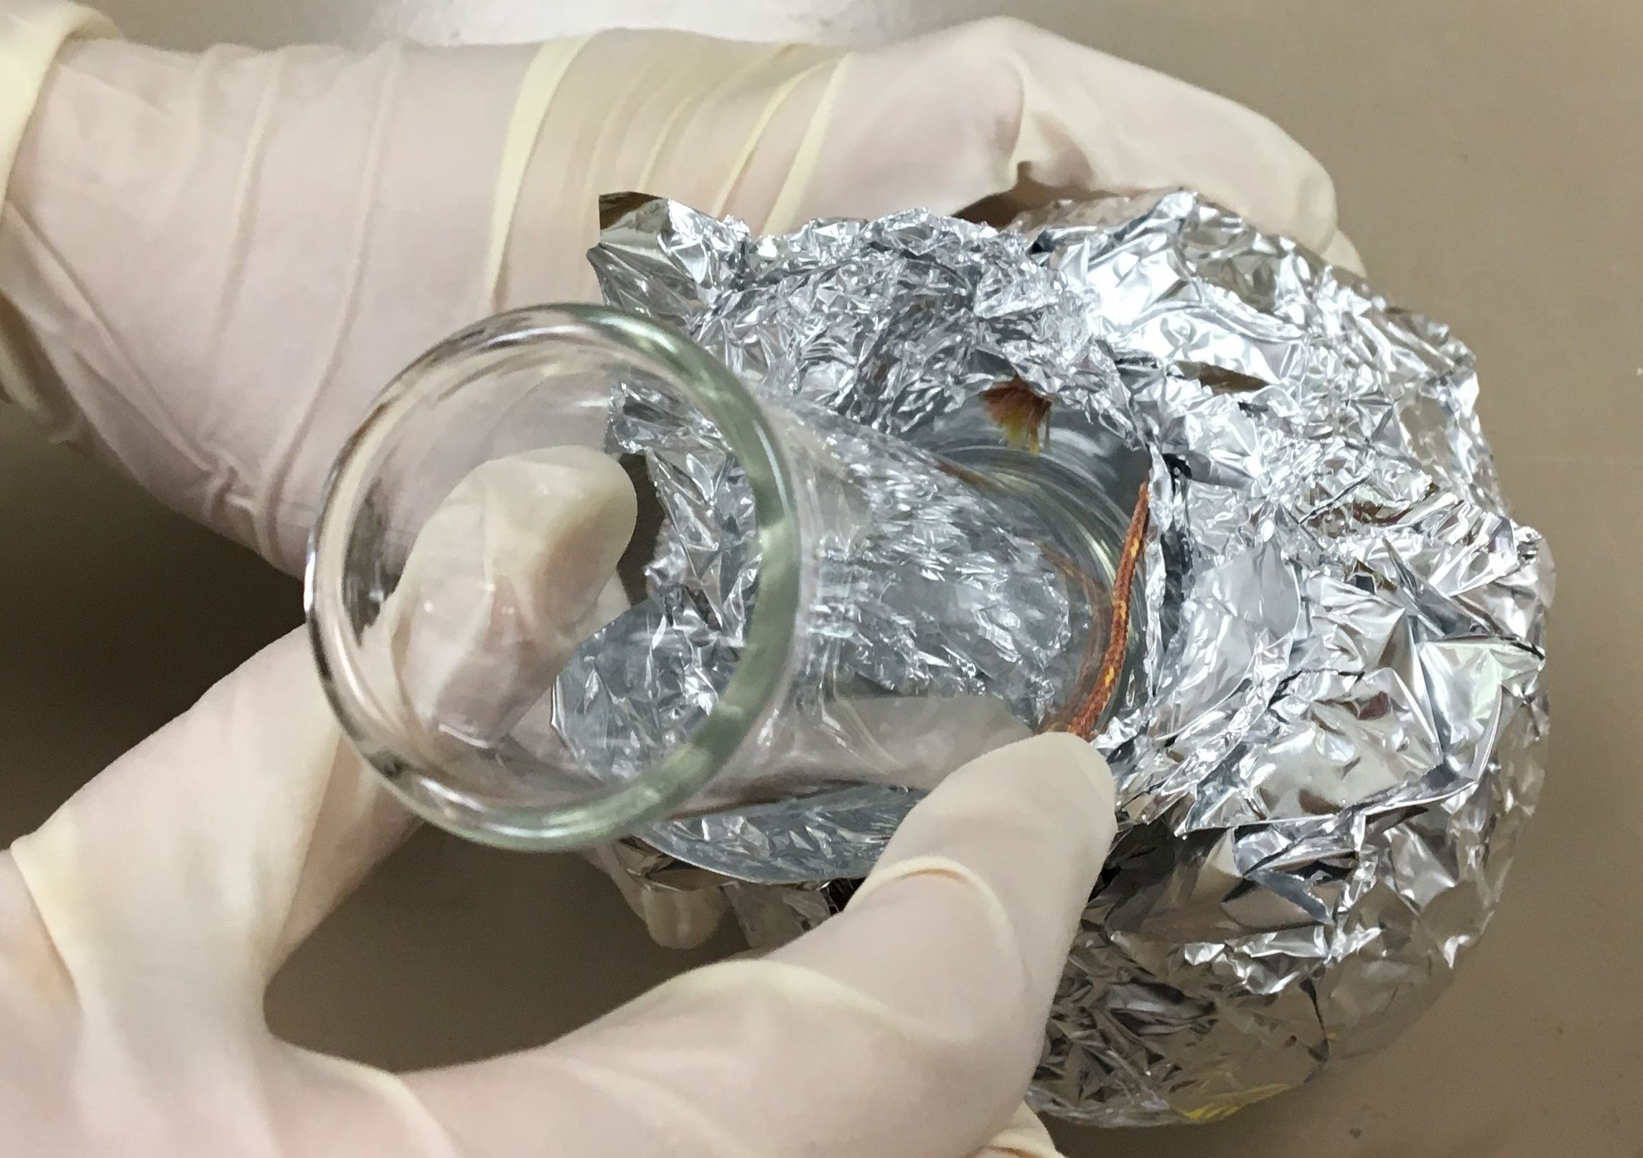
Thermocouple 1

Slide 12
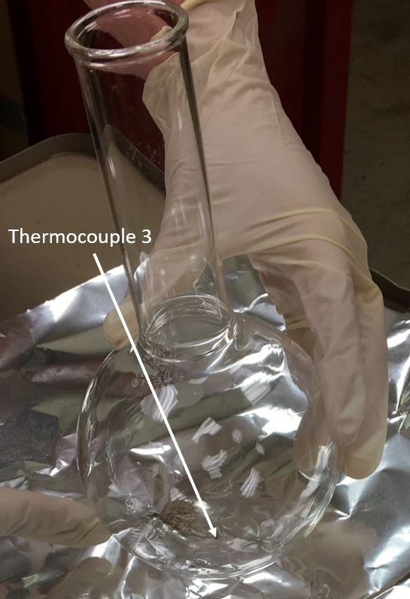
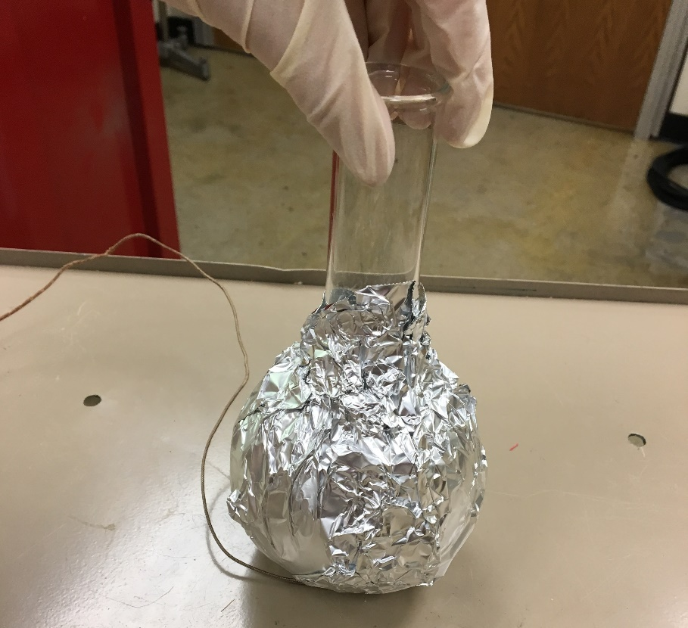
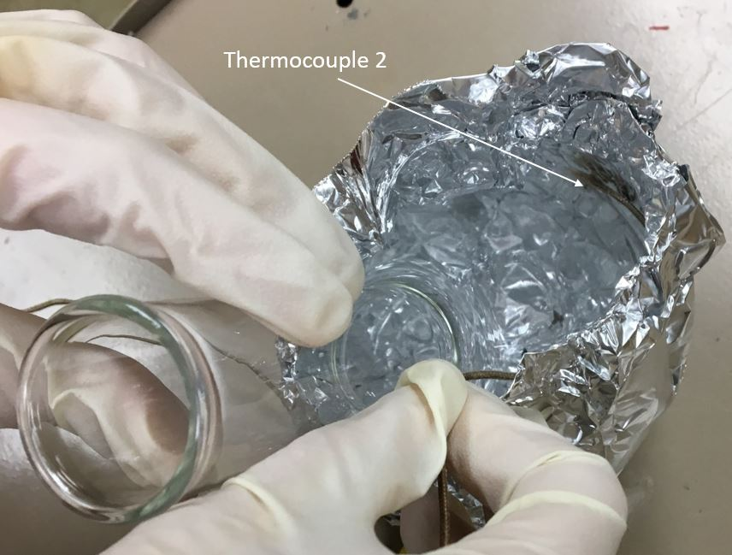
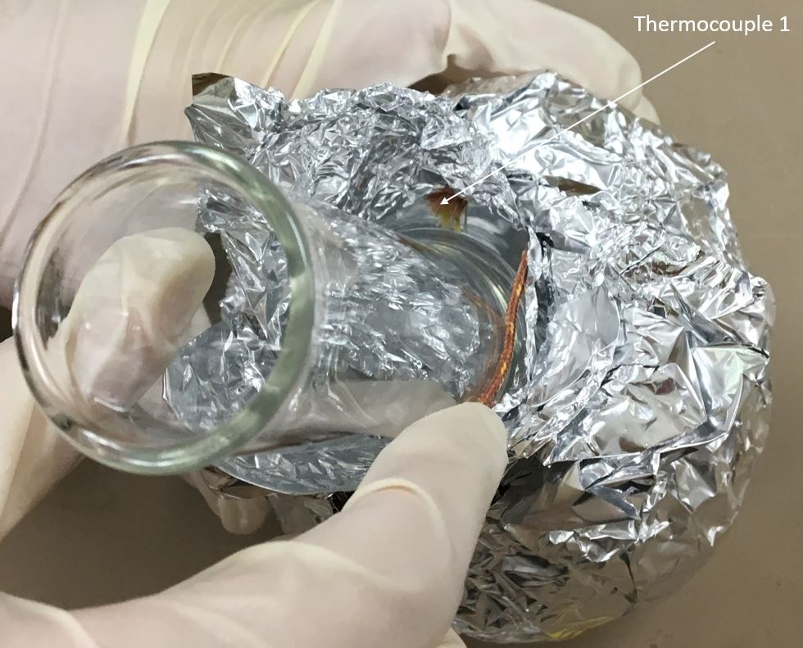
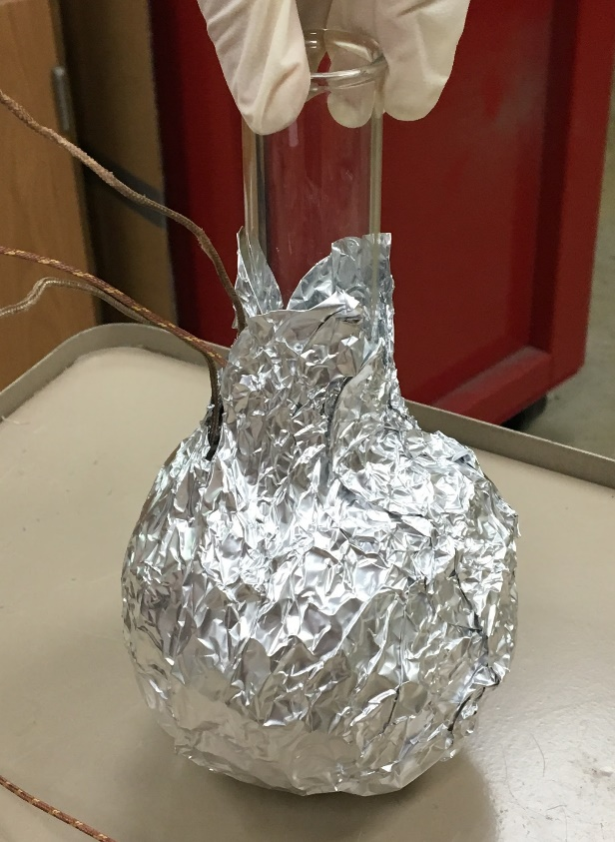
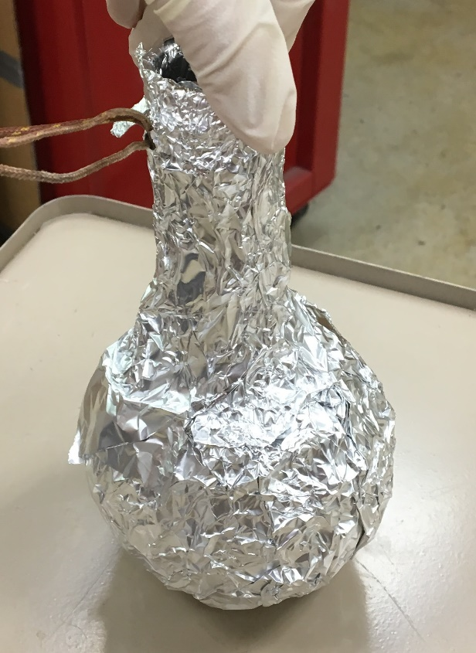
1
2
3
4
5
6

